Slide 1
Sales Analytics Report

Slide 2
Data Collection
Collection of Data: The Retail Transactions Data is downloaded from Kaggle which contains two datasets i.e Retail Data Response and Retail Data Transactions in the form CSV file.
Data Base Setup: The dataset is loaded into the SQL Workbench and done a some work on dataset by using DDL commands. But in this project I did not use SOL more because I did Data cleaning and Data merging itself in python.

Slide 3
Importing Data & Data Merging
Importing Data: As we know that Python is very powerful for Data Analytics because it has a Special and more libraries for Data Manipulation and Data Exploration.In this project we imported a pandas library into the jupyter notebook for Data Manipulation.I have read the two datasets in the form of ‘pd.read_csv’ .
Data Merging: I have merged the two datasets by using ‘merge()’ function with left join.

Slide 4
Data Cleaning
Data Statistics: Before Data Cleaning , we have to know some statistical features about data i.e data types of data ,Numerical columns in data as well as we have to know that how many missing values are there in data.The key functions that are used for Data Statistics in this project are dtypes,shape,pd.head(),pd.tail(),describe(),info(),isnull().sum()
Data Cleaning: Data Cleaning is done by the remove the duplicates in data , fill the missing values or null values with mean,mode ,median strategies and drop the rows and columns in the data.

Slide 5
Data Cleaning
But in this final project , we should not drop the duplicates because the customer done various transactions with same customer_id.
We encounter 31 missing values in the dataset under the response column out of the 124969 values. The missing values are less than 25% , So I drop the rows which has 31 missing values which do not have impact for further Analysis.
After the I have changed the transaction date data type into date format by using ‘pd.to_datetime’ function and as well as response column data type is changed to integer format by using ‘astype(int)’function.

Slide 6
Data Preparation
Checking Outliers: As we know that checking outliers are very important ,if outliers are present in data it could very difficult for predictions by using ML model. There are various methods are there to find outliers in the data. They are
Z-score
IQR(Inter Quantile Range)
Box plot using seaborn library
In this project , I used Z-score and Box plot to find the outliers. But ,there is no outliers are present in the data.

Slide 7
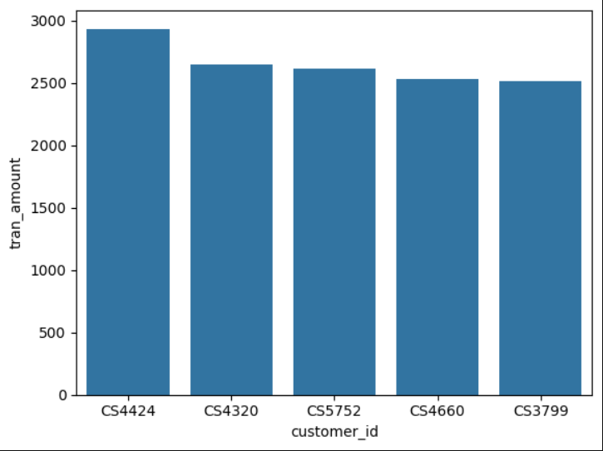
Data Exploration Analysis
In this Analysis , the data visualization is done by using various graphs to get business insights.
In the Right graph, X-axis indicates customer_id and Y-axis indicates transaction amount of customer.
Customer ‘CS4424’ done the highest transaction amount nearly 2900 and Customer ‘CS3799’ done the lowest transaction amount nearly 2500.

Slide 8
Advanced Analytics
The Advanced Analytics mainly divided into four parts. They are
Time Series Analysis
Cohort Segmentation
Churn Analysis
Analyzing top 5 Customers

Slide 9
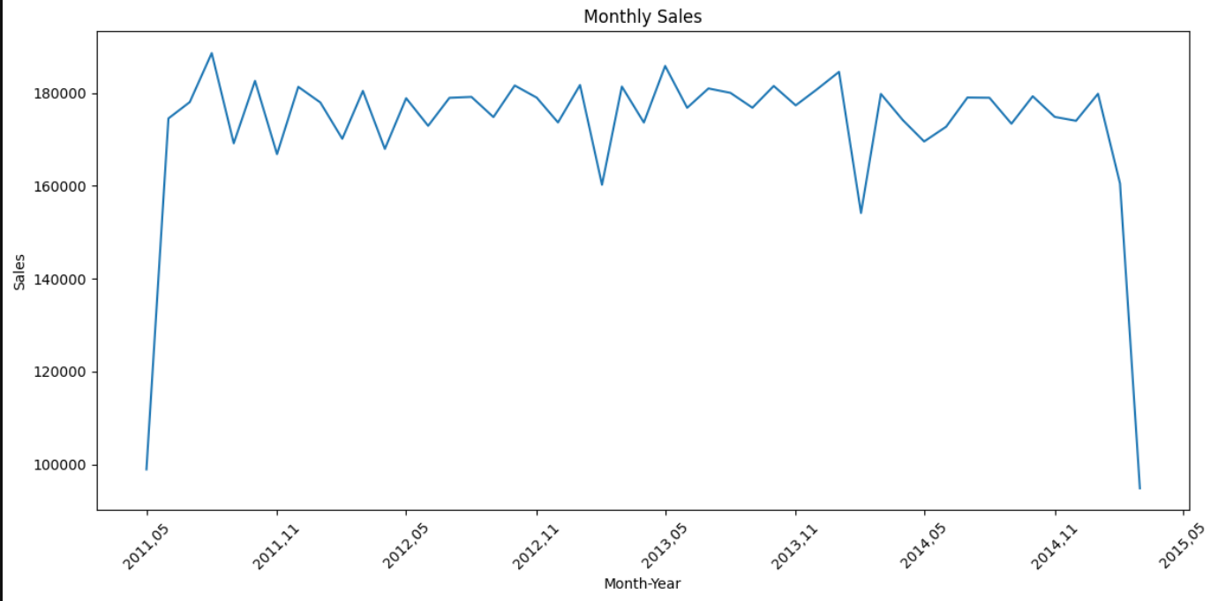
1. Time series Analysis
In this graph, the highest sum of transaction amount is done in the year of 2011-08 month i.e 188605.
The lowest sum of transaction amount is done in the year of 2015-03 month i.e 94829.

Slide 10
2. Cohort Segmentation
In this Segmentation, the New dataset is created from the existing dataset with specific conditions.
As we know that , customer_id is a primary key .
In the New dataset four columns are created. They are
Recency
Frequency
Monetary
Segment

Slide 11
2. Cohort Segmentation
Recency: It means the maximum transaction date of each customer.
Frequency: It means the number of transactions are done by each customer.
Monetary: It means the sum of transaction amounts of the each customer.
Segment: This column has three customer segments i.e P0,P1,P2. These 3 customer segments are created with specific conditions by using ‘def’ and ‘apply’ function.

Slide 12
2. Cohort Segmentation
P0 : This segment falls under recency is greater than 2012 and frequency is greater than or equal to 15 and monetary is greater than 1000.
P1 : This segment falls under recency is greater than or equal to 2011 and less than 2012 , frequency falls under less than 15 and greater than 10 , monetary falls under less than or equal 1000 and greater than or equal 500.
P2 : This segment fall under ,If above P0 & P1 conditions are not satisfied.

Slide 13
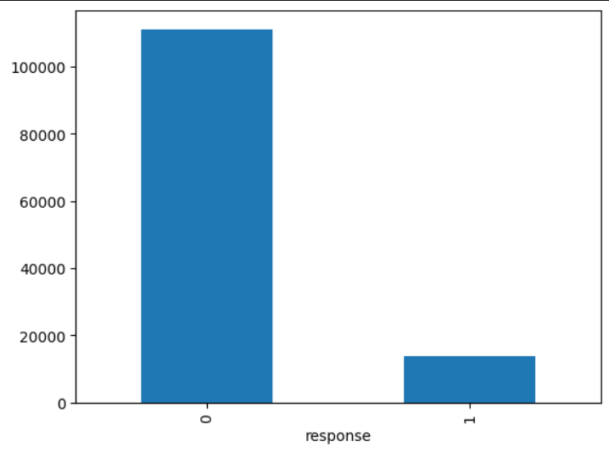
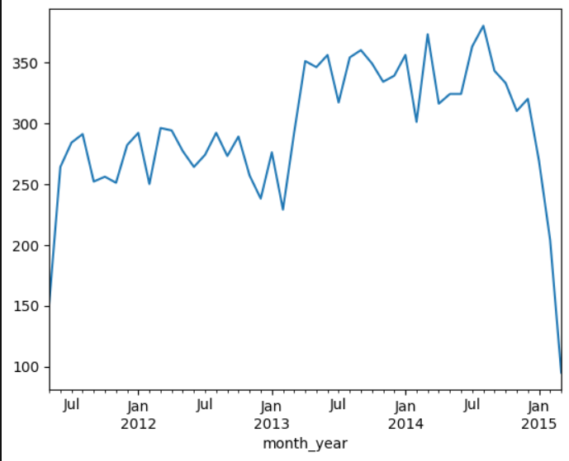
3. Churn Analysis
In the Right bar graph, ‘0’ indicates the customers migrated to other company and ‘1’ indicates the customers are satisfied with the company services.
111127 customers are churned and 13842 customers are not churned.
In Right Line chart, the maximum customers are satisfied in the year o 2014-08 month and the minimum customers are satisfied in the year of 2015-03 month.

Slide 14
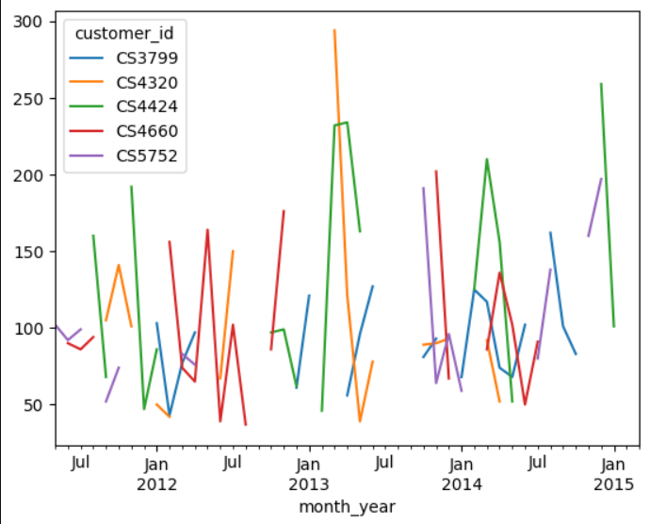
4. Analyzing Top 5 Customers
In the Right Line chart, the customer ‘CS3799’ done highest transactions i.e 294 in the year of 2011-06 month.
The customer ‘CS5752 ’ done lowest transactions i.e 36 in the year of 2011-06 month.

Slide 15
Conclusion
In summary, the integration of data cleaning, effective visualization, and advanced analytics techniques forms a robust foundation for uncovering valuable business insights. By thoroughly analyzing sales data, organizations can identify key trends, understand customer behavior, and detect performance patterns with precision. These insights not only enhance strategic decision-making but also serve as critical inputs for building predictive machine learning models and deep learning systems. As businesses continue to embrace data-driven approaches, these practices are proving to be indispensable for achieving sustained growth, operational efficiency, and competitive advantage.

